Slide 1
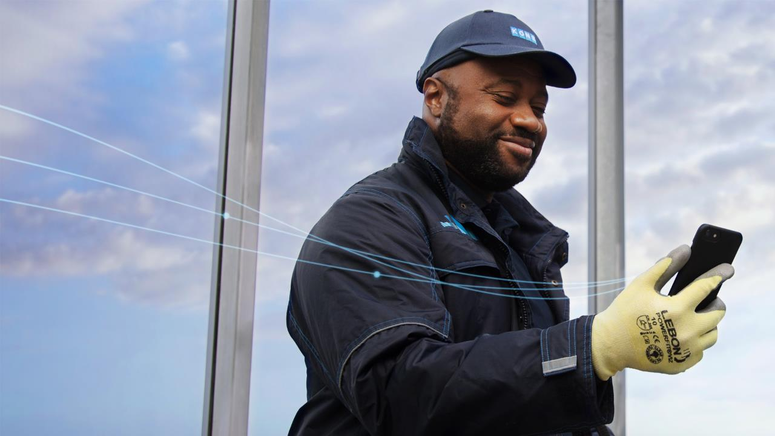
KONE Care™ DX
The future of smart and sustainable maintenance

Slide 2

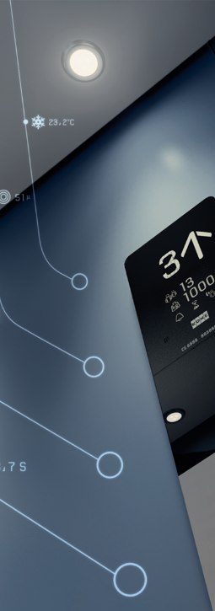
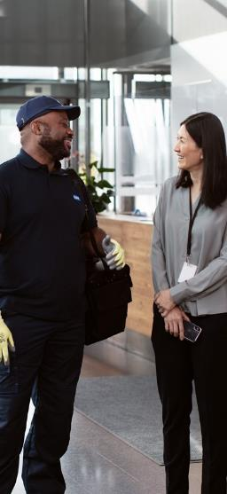

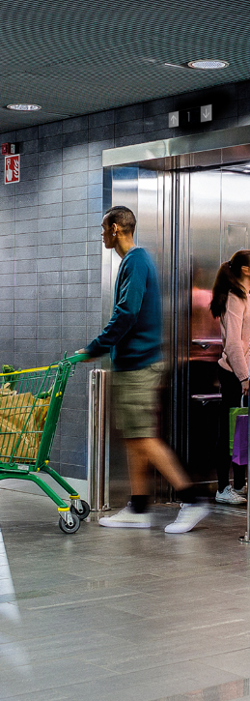

Content
KONE Care™ DX
5
  KONE Care™ DX
  The future of smart and sustainable maintenance
  Intelligently prolong your elevator's life
Around the clock support at your fingertips
1st carbon neutral elevator maintenance service in the industry
Create tailor-made experiences

Slide 3
KONE DX: A short introduction to your smart and sustainable elevator
The KONE DX elevator class represents a revolution in smart elevator technology. A KONE DX elevator is digitally upgradeable, utilizing built in connectivity to optimize functionality and add long-term value with a host of in-ride entertainment and information options that make life easier and improve user experience.
Our DX offering helps your elevator work harder for longer, with AI-powered predictive maintenance solutions that protect your investment and contribute to a healthier, happier building – now and in the future.
KONE DX is a great investment for sustainability - it is energy-efficient, long-lasting and safe and when modernized, up to 90% of the metals used can be recycled.

Slide 4
Why KONE Care™ DX?
At KONE we're dedicated to helping you construct the smart and sustainable cities of the future – and KONE Care™ DX is one the fundamental building blocks in our mission.
Did you know that 95% of today's buildings will still be standing by 2050? | KONE DX class elevators use the power of connectivity to unlock a world of value | We've pledge to cut emissions in our operations by 50% by 2030
That's why it's so important that building design and technology is both sustainable –and upgradeable. | Digital upgrades improve people flow, prolong elevator lifespan and make your building smarter and more adaptable | … and while actively working to meet our science-based targets, we're already offsetting carbon emissions from KONE Care™ DX maintenance.
KONE Care™ DX is the smartest way to make sure your elevator can move with the times, seamlessly evolving with help of predictive maintenance, connectivity and transparency.​

Slide 5
What does KONE Care™ DX do?
KONE DX Care makes life for you and your tenants easier, protects your equipment and contributes to a more sustainable future for your building. Here are 5 ways KONE Care™ DX can help you and your elevator:
1.
We constantly monitor the performance of your KONE DX elevator through our connected, AI-powered services, such as KONE 24/7 Connect, which analyzes your equipment’s health and predicts future repairs.
2.
Intelligent troubleshooting, software upgrades and remote updates can address issues quickly, with experienced technicians on-hand to inspect equipment when you need them.
3.
Online reports, instant phone notifications and support from our team keep you updated on your elevator’s performance and health.
4.
Repairs are planned proactively, increasing the first-fix rate, minimizing carbon emissions from unplanned visits.
5.
Your KONE DX Class elevator can have easy to update digital services which can be flexibly activated and scaled to boost user experiences in your building.

Slide 6
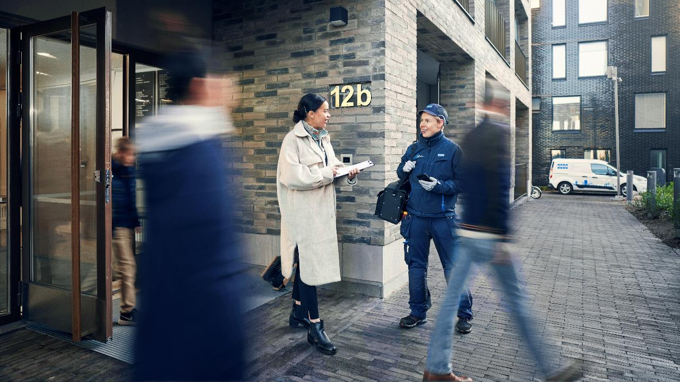
A lifetime of reliable service
WHY CHOOSE KONE CARE™ DX MAINTENANCE?
We want your relationship with your intelligent, connected KONE DX elevator to be a long and happy one. The best way to protect your investment and keep everything running safely and smoothly is to let us take care of it with the same level of care and attention we gave it when it was being built. With KONE Care DX we’re with you every step of the way, for the entire life of your equipment.
Another way to cut
your carbon footprint
KONE Care DX is the first carbon neutral maintenance offering in the industry. We offset the CO2 emissions caused by direct and indirect maintenance activities, and the aim is that all KONE Care DX maintenance activities will be carbon neutral thanks to a combination of emission reduction actions already in place and our carbon offsetting program.
Less downtime
and faster repairs
Thanks to built-in connectivity
we can keep an eye on your
equipment around the clock
and identify and resolve
issues without anyone even
noticing there was a problem
in the first place. And since we
already know the root cause
of any problems, if something
unexpected happens we can fix
it more quickly too.
Always
up to date
Take advantage of the latest
features and functionalities through automatic, remote software updates and upgrades. As well as keeping your equipment secure, this means you can add new smart building solutions to make everyday life even easier for the people who use your building. The possibilities are endless.
4
1
2
3
Support from the
best in the business
No one knows your DX equipment like we do, so let our expert team of service technicians take care of it with the same attention to detail and commitment to quality as when it was being built. If something needs replacing or repairing, we’ll always have the needed spare parts available to get the job done quickly and keep people moving safely and smoothly around your building.
6
13 April 2022
Confidential | © KONE Corporation

Slide 7
WHAT ARE THE BENEFITS?
Intelligently prolong your elevator's life
Keep your KONE DX elevator running at the peak of its health. With KONE 24/7 Connect, AI-powered predictive maintenance, advanced analytics, remote updates and intelligent troubleshooting, KONE Care™ DX is the smartest way to maximize uptime and prolong your elevator’s life.
Remote software and security updates
Intelligent troubleshooting
70% of maintenance activities performed proactively and 40% fewer entrapments*
40% fewer faults experienced*
*during 3 years of service

Slide 8
Support at your fingertips
WHAT ARE THE BENEFITS?
With round-the-clock support and help from our expert team, you’ll never be left in the dark. Talk to our people whenever you need to or check the status of your elevators with data-driven insights, through interactive online reports, mobile notifications and seamless digital updates.
Online health reports in real-time
Instant notifications delivered to your phone
Around the clock in-person support from our customer call center
Easy digital communication through KONE Online or KONE Mobile
Experienced technicians on-hand for in person call-outs
Around the clock support delivered in person and digitally

Slide 9

WHAT ARE THE BENEFITS?
Benefit from sustainable maintenance
Reduce unplanned maintenance activities and utilize our predictive services that are making it easier to plan proactively for upcoming repairs. Plus, KONE Care™ DX maintenance visits will be carbon compensated through our offsetting program - that’s better for the planet.
Proactive and preventative care
Carbon compensated maintenance
1st carbon neutral elevator
maintenance service in the industry
The service offering in terms of carbon compensated service may vary from country to country
Notes:
We compensate the remaining carbon emissions caused by direct (like emissions from driving and facilities) and indirect (like manufacturing of spare parts) maintenance activities.

Slide 10





Carbon neutral maintenance – how do we do it?
ENERGY EFFICIENT ELEVATORS
MEASURE
REDUCE
COMPENSATE
21 elevators with the best A-class rating
Regenerative drive and other innovations
We calculate the CO2 impacts of all the activities associated with maintaining the equipment and verify the results with third party verifiers
We actively reduce our CO2 emissions
The remaining carbon emissions will be calculated and compensated
Spare parts
Maintenance
visits
Facilities
In line with KONE’s Climate Pledge targets.
According to KONE’s Environmental Guidelines and
overall emission reduction targets

Slide 11
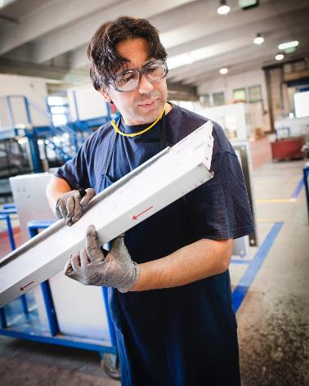
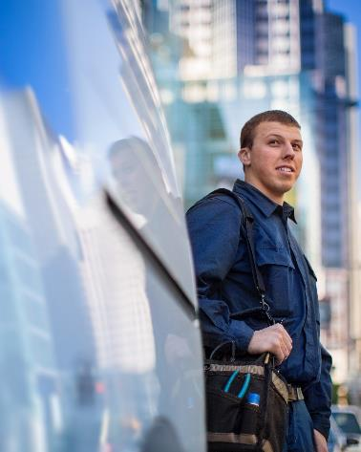
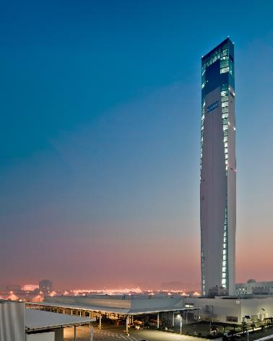

Carbon neutral maintenance – how do we reduce?
SPARE PARTS
MAINTENANCE VISITS
FACILITIES
94% of waste recycled currently in own operations
Working with suppliers to reduce CO2
(parts, packaging,…)
Innovative solutions
(e.g. travelling cable, batteries, repairs)
Optimized route planning for reduced driving
Moving towards low emission car fleet
Predictable maintenance
Moving towards 100% renewable energy
In line with KONE’s Climate Pledge targets.
According to KONE’s Environmental Guidelines and
overall emission reduction targets

Slide 12
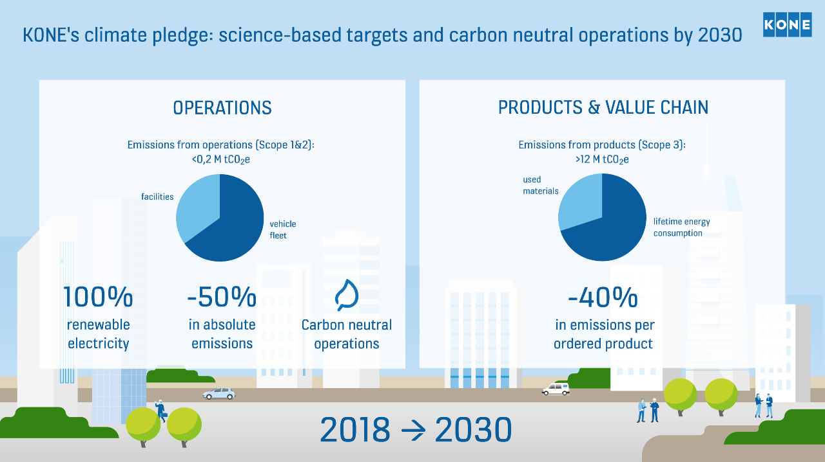

Slide 13
Sustainable solutions and services throughout the building life-cycle
Sustainable
building design
SAFE AND HEALTHY
ENERGY EFFICIENT
CIRCULAR
Safe and healthy
materials and solutions
- Carbon neutral elevator until handover
Recyclable
resources
Best-in-class
energy efficiency
Improved energy efficiency
through modernization
Carbon-optimized maintenance
Notes:
We offer sustainable solutions and services throughout the building life-cycle: From early building design, through choice of materials and development of solutions, with high energy efficiency, carbon optimized maintenance, long life-time, until modernization and reusage and recycling of materials. Our offering is safe, healthy, energy efficient and circular. (More about circularity below.)
SUSTAINABLE BUILDING DESIGN
Designing future-proof, adaptable, inclusive and
accessible buildings with the support of KONE People Flow planning and consulting.
Our smart digital solutions and embedded connectivity enable future adaptability and endless possibilities for personalised add-on services and efficiency in building management
Support in green building certification (e.g. BREEAM, LEED, WELL)
Building product certifications (e.g. SGBC, BVB)
Third party-verified Environmental Product Declarations (EPDs)
SAFE & HEALTHY MATERIALS AND SOLUTIONS
Efficient use of durable and sustainably sourced materials
Non-toxic materials and health-promoting solutions like antimicrobial surfaces, handrail sanitizer, air purifier and touchless solutions enable safer, more hygienic people flow
Making buildings accessible to all users through digital solutions and the right choice of equipment
Health Product Declarations (HPDs) for our products
BEST-IN-CLASS ENERGY EFFICIENCY
Widest product range with A-class energy performance according to ISO 25745
Energy-saving solutions: energy-efficient motors, regenerative drive,
long-lasting LED lighting with dimming,
advanced standby solutions and KONE UltraRope®
Energy and carbon-emission modeling
CARBON-OPTIMIZED MAINTENANCE
Moving towards low-emission car fleet
Reducing unnecessary vehicle use with optimized route planning and by aiming for high first fix rates
Optimized spare part inventories and -logistics
Extending equipment lifetime and reducing unnecessary vehicle use through fewer unplanned visits with remote monitoring via KONE 24/7 Connected Services
Industry-first carbon neutral maintenance
service – KONE Care DX
IMPROVED ENERGY EFFICIENCY THROUGH MODERNIZATION
Durable materials enable long equipment lifetime
Modernization reduces energy consumption and improves accessibility and safety
RECYCLABLE RESOURCES
Partial modernization offers the possibility to reuse some parts
Developing processes for recycling materials and parts,as well as for increasing the use of recycled materials and recyclable packaging
90% of the metals used in KONE’s solutions can be recycled
94% of waste is currently recycled in own operations (2020)
------------------------------------------------------
What is circular economy (circularity)?
- Designing products for multiple use, for easy repair and maintenance.
- Utilizing products for as long as possible and for the maximum value.
- Using non-toxic, renewable, recycled and recyclable materials.
- Reducing the usage of finite resources and eliminating waste.
- Developing new business models around sharing and reusing products
-> KONE’s operations, products and services supports the circular economy.
______________________________________________________________________________________
Additional information as background on circularity
How KONE contributes to circular and sustainable cities:
Cities consume over 75% of natural resources, produce over 50% of global waste, and emit between 60-80% of greenhouse gases. The circular economy aims at combatting the excessive use of resources and the harmful environmental impacts that go with it. It’s about reducing the amount of resources we use in the first place, and once we do take resources into use, we should aim to utilize them for as long as possible for the maximum value. This can be done, for example, by creating long-lasting products, maintaining and refurbishing them and also, by developing new business models around sharing and reusing, for example. In the circular economy, the take-make-dispose way of consuming and producing is transformed into a closed loop of resources where nothing goes to waste.
Circularity already in the KONE business model itself:
KONE’s core business model supports the circular economy. New products -> Maintenance -> Modernization when at end of life/material recovery when possible -> starts all over….
We provide long-lasting products that are reliable and energy-efficient. For example, we currently have the widest product range with the best energy efficiency according to the international energy performance standard, ISO 25745. For the circular economy, it’s also extremely important that we use healthy materials so that our products can be safely used, maintained and modified along their long lifecycle.
In the circular economy, we must use effectively the resources we take into use. That is where our services play an important role. Our intelligent People Flow® services, and maintenance and modernization services help ensure that elevators, escalators and doors are, firstly, optimized for the right needs, secondly, run efficiently throughout their long lifetime and thirdly, can be upgraded and refurbished for the versatile use within buildings. For example, KONE 24/7 Connected Services can predict maintenance needs for the equipment, meaning fewer faults and faster repairs. Digital technologies and connectivity are significant enablers for the implementation of the circular economy.
In all our operations, our top priority has long been resource efficiency and minimizing our environmental impact. We improve material efficiency in manufacturing, for example, through robotics and automatization. We aim to minimize waste and maximize recyclability and the opportunities for reuse. For example, the vast majority of our packaging materials can be recycled, and we already have reusable packages as part of our day-to-day logistics process in between our factories and suppliers. When transitioning to a low-carbon circular economy, it’s important that we power our operations with electricity from renewable sources. Our target is to increase the share of green electricity to over 50% out of all electricity consumption by 2021.
With all this, we have a good foundation for further exploring circular and sustainable business practices. Currently, 90% of the metals used in KONE solutions can be recycled, and we work together with our suppliers to increase the proportion of recycled content in our products.
This is how we ultimately enable smart construction, best People Flow and extended life cycle, both for our equipment and the building, and create value for our customers in the circular economy.

Slide 14

Overview of CO2 emissions from maintenance
NOTE – This slide should be localized for each country. Please remove this pink textbox after localization
CO2 emissions (kg/UN/year)
0
0
0
1
2
Ropes
Drive
Other
Spare parts total
Fuel
Cars
Vehicle fleet total
KONE facilities
Servers
Mobile phones
Other
Other total
Total
Spare parts
Vehicle fleet
Facilities
Other
Total
compensation

Slide 15
It enables tailor-made experiences
WHAT ARE THE BENEFITS?
Delight and inspire with hand-picked digital services that can be easily activated and scaled to boost user experiences in your building. KONE Care™ DX is the smartest way to leverage the power of connectivity and seamlessly evolve your KONE DX elevator as you go – so you can stay ahead of the curve, both now and in the future. Online health reports in real-time
Tailor-made experiences
Easy integration of new digital services
No need to retrofit to upgrade your elevator
It's adaptable and scalable
Connectivity brings smoother
and safer people flow

Slide 16

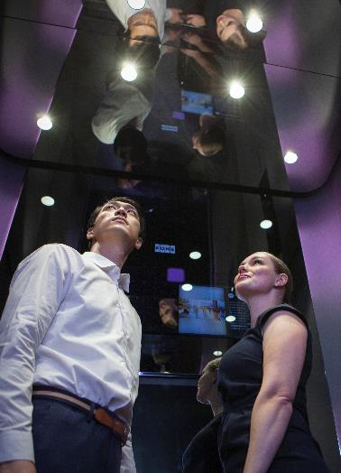

KONE Digital Services
Increase the value and attractiveness of your building by maximizing the potential of your elevators
1
2
3
Improve building
performance and operations
Create a smooth and unique user experience
Make better decisions with insights based on data
Ensure excellent availability and service transparency
KONE 24/7 Connect
Operational APIs
  Equipment Status API
  Service Info API
Reduce workload by digitalizing information sharing and monitoring
KONE Information
Keep tenants informed and entertained
KONE Information
KONE Elevator Music
Elevate experience with contactless people flow and easy integrations
KONE Elevator Call
Experience APIs
  Elevator Call API
  Service Robot API
Partner Solutions
Base investment decisions on hard data, not guesswork
KONE 24/7 Connect
KONE 24/7 Planner
Operational APIs
  Equipment Status API
  Service Info API

